Slide 1
Transnational
On-Demand Access Actions
Joint collaborative on-demand actions capitalising on existing assets to share technology, methods, expertise, facilities and knowledge on marine threats, hazards and observations in the Mediterranean Sea
Prof. Aldo Drago - Malta
SHAREMED partners - Italy (PL); France; Spain; Portugal; Slovenia; Croatia; Montenegro
SHAREMED Internationalisation Workshop , 13/14th September 2022

Slide 2
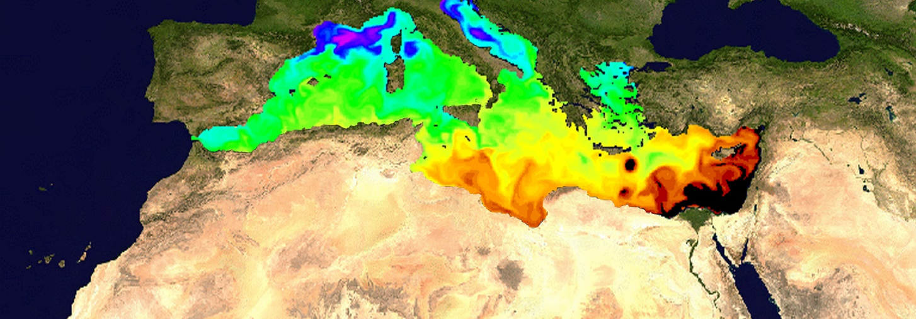
Major innovative and practical capitalisation endeavour through joint sub-projects offered by donors to Mediterranean recipients, consisting of doable joint actions to implement and set up systems at the recipient sites, or to train, or to undertake joint observations and assessments.

Slide 3
What is it?
Innovative on-demand approach
ON OFFER: project deliverables and partner expertise & resources
RECIPIENTS: Mediterranean entities including non-EU
ACTIONS: - joint supportive or complimentary actions to aid existing projects and initiatives (national and international)
- address specific problems/needs, and
- planning efforts for future implementation
HIGHLIGHT
Target recipients are not only scientists, but also environmental managers, decision makers, stakeholders, and
private users

Slide 4
What is it?
Offers related to the thematic of SHAREMED
(marine hazards and observations)
Numerical model implementation in recipient domain
Delivery of data for a specific application
Training of personnel
Joint assessment of an environmental problem
Intervention on an existing recipient project
Support to a regional network or initiative
Environmental assessment
Expert intervention
other
HIGHLIGHT
Target recipients are not only scientists, but also environmental managers, decision makers, stakeholders, and
private users

Slide 5
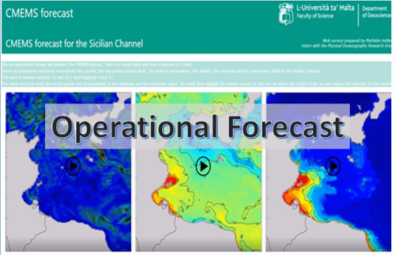
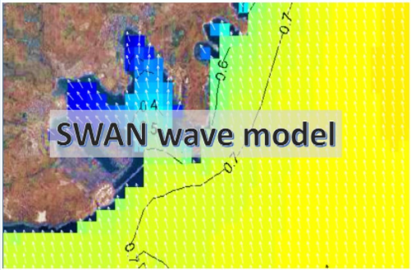
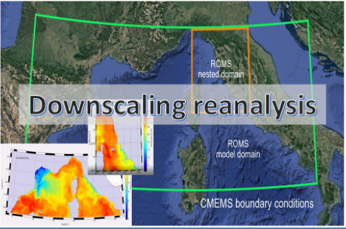
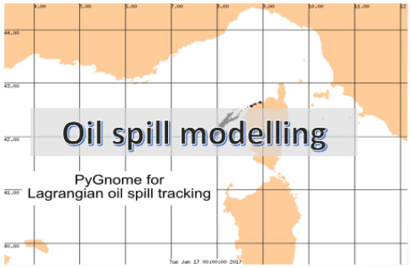
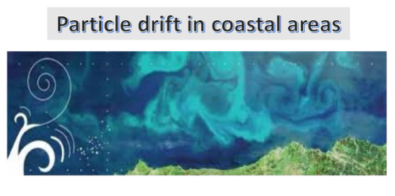
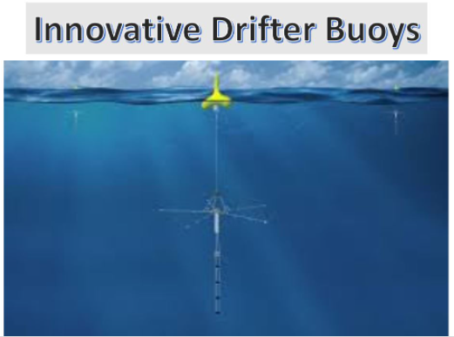
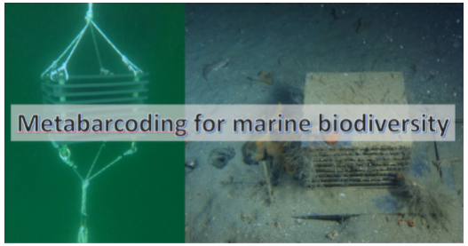
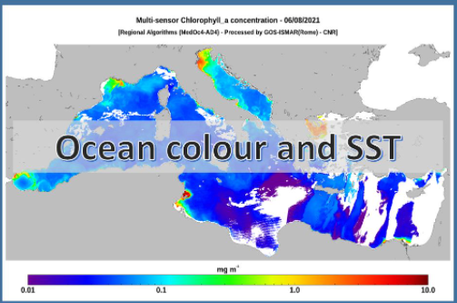
What is on offer

Slide 6
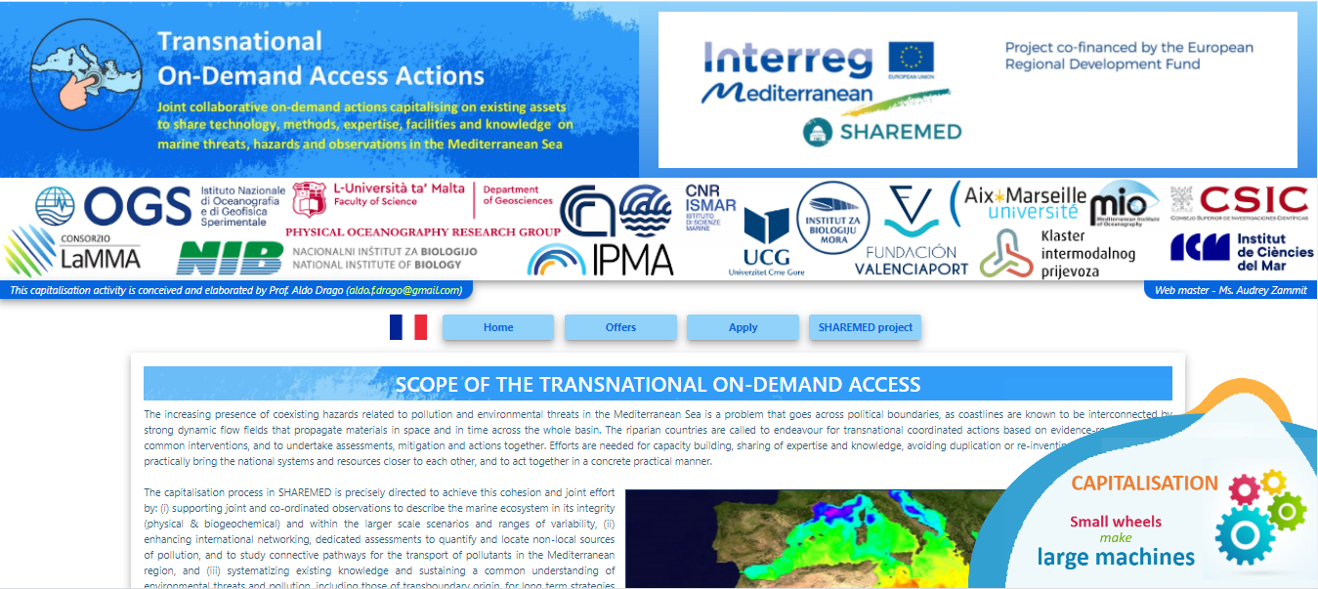
Presence on the web
www.capemalta.net/sharemed-on-demand

Slide 7
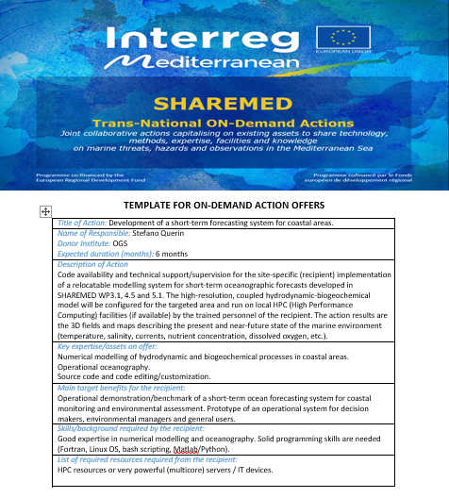
Factsheet of information on each offer
TITLE
RESPONSIBLE
WHAT IS ON OFFER
EXPECTED TIME FRAME FOR EXECUTION
REQUISITES FROM THE RECIPIENT
HOW THE ACTION WILL BE CONDUCTED

Slide 8
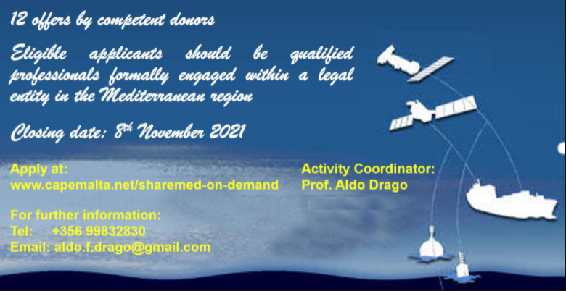
Two Calls issued in October 2021 and February 2022
Applicants are expected to fill in an online application form
letter of intent by the applicant/s
letter of recommendation by the responsible of the legal entity to which the applicant/s pertain
list of resources made available by the applicants for the execution of the activity
letter of commitment from the part of the applicants

Slide 9
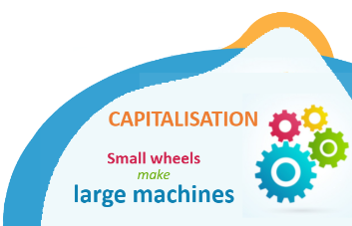
8 offers were selected from two calls by a total of 17 requests from 12 institutions and from 7 countries
Morocco (2), Algeria (1), Tunisia (6), Egypt (2), Spain (1), Montenegro (2), Greece (3)
Several Actions already completed
Reporting by donor and another by recipient
Will be repeating the experience in a large dedicated capacity building project
For further info, contact
Prof. Aldo Drago
aldo.f.drago@gmail.com

